Slide 1
Clustering and K-Means

Slide 2
What is clustering?
Clustering is the classification of objects into different groups, or more precisely, the partitioning of a data set into subsets (clusters), so that the data in each subset (ideally) share some common trait - often according to some defined distance measure.

Slide 3
K-Means
Unsupervised learning → where we dont provide the algorithm WHAT is the RIGHT answer?
The goal is to segment or categorize data automatically
K-means make K groups of data points in d-dimensions
  Where d is the number of parameters

Slide 4
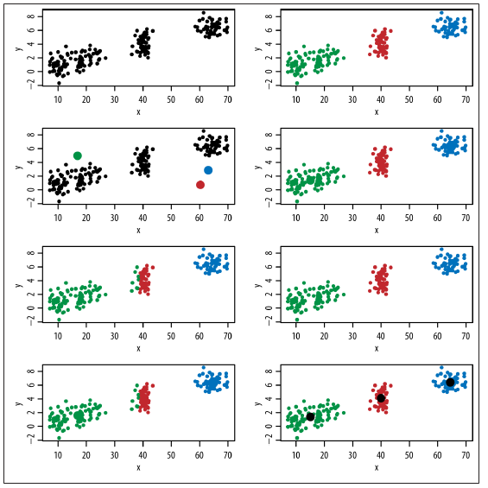
If data has many parameters it is not possible to identify groups like this

Slide 5
K-Means Algorithm
We may need to try different values for k before we arrive at a natural grouping
1. Initially, randomly pick k centroids (or points that will be the center of your clusters). Try to make them near the data but different from one another.
2. Then assign each data point to the closest centroid.
3. Move the centroids to the average location of the data points assigned to it.
4. Repeat the preceding two steps until the assignments don’t change, or change very little.

Slide 6

How the K-Mean Clustering algorithm works?

Slide 7
Step 1: Begin with a decision on the value of k = number of clusters .
Step 2: Put any initial partition that classifies the data into k clusters. You may assign the training samples randomly, or systematically as the following:
1.Take the first k training sample as single- element clusters
2. Assign each of the remaining (N-k) training sample to the cluster with the nearest centroid. After each assignment, recompute the centroid of the gaining cluster.

Slide 8
Step 3: Take each sample in sequence and compute its distance from the centroid of each of the clusters. If a sample is not currently in the cluster with the closest centroid, switch this sample to that cluster and update the centroid of the cluster gaining the new sample and the cluster losing the sample.
Step 4 . Repeat step 3 until convergence is achieved, that is until a pass through the training sample causes no new assignments.

Slide 9

A Simple example showing the implementation of k-means algorithm
(using K=2)

Slide 10


Step 1:
Initialization: Randomly we choose following two centroids (k=2) for two clusters.
In this case the 2 centroid are: m1=(1.0,1.0) and m2=(5.0,7.0).

Slide 11




Step 2:
Thus, we obtain two clusters containing:
{1,2,3} and {4,5,6,7}.
Their new centroids are:

Slide 12

Step 3:
Now using these centroids we compute the Euclidean distance of each object, as shown in table.
Therefore, the new clusters are:
{1,2} and {3,4,5,6,7}
Next centroids are: m1=(1.25,1.5) and m2 = (3.9,5.1)

Slide 13

Step 4 :
The clusters obtained are:
{1,2} and {3,4,5,6,7}
Therefore, there is no change in the cluster.
Thus, the algorithm comes to a halt here and final result consist of 2 clusters {1,2} and {3,4,5,6,7}.

Slide 14

PLOT

Slide 15
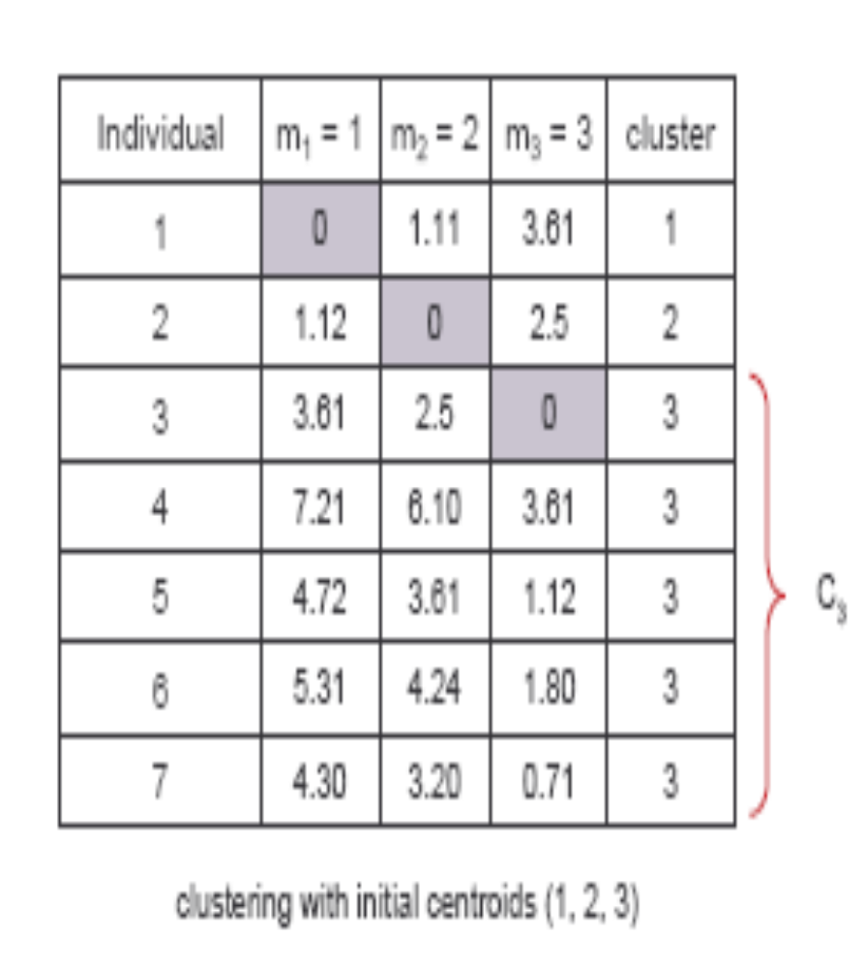
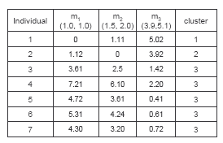
(with K=3)
Step 1
Step 2

Slide 16
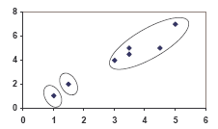
PLOT

Slide 17
Real-Life Numerical Example of K-Means Clustering
We have 4 medicines as our training data points object and each medicine has 2 attributes. Each attribute represents coordinate of the object. We have to determine which medicines belong to cluster 1 and which medicines belong to the other cluster.
Object | Attribute1 (X): weight index | Attribute 2 (Y): pH
Medicine A | 1 | 1
Medicine B | 2 | 1
Medicine C | 4 | 3
Medicine D | 5 | 4

Slide 18
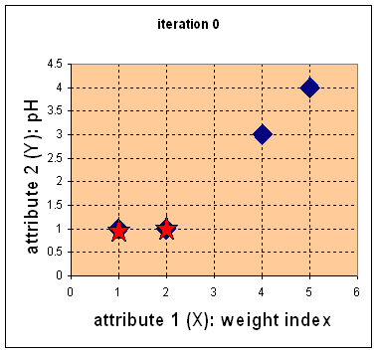
Step 1:
Initial value of centroids : Suppose we use medicine A and medicine B as the first centroids.
Let and c₁ and c₂ denote the coordinate of the centroids, then c₁=(1,1) and c₂=(2,1)

Slide 19
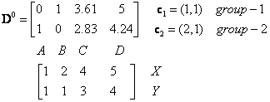
Objects-Centroids distance : we calculate the distance between cluster centroid to each object. Let us use Euclidean distance, then we have distance matrix at iteration 0 is
Each column in the distance matrix symbolizes the object.
The first row of the distance matrix corresponds to the distance of each object to the first centroid and the second row is the distance of each object to the second centroid.
For example, distance from medicine C = (4, 3) to the first centroid is , and its distance to the second centroid is , is etc.

Slide 20
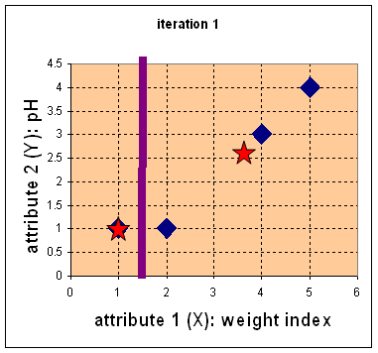

Step 2:
Objects clustering : We assign each object based on the minimum distance.
Medicine A is assigned to group 1, medicine B to group 2, medicine C to group 2 and medicine D to group 2.
The elements of Group matrix below is 1 if and only if the object is assigned to that group.

Slide 21
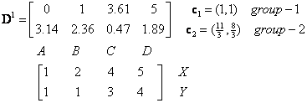
Iteration-1, Objects-Centroids distances : The next step is to compute the distance of all objects to the new centroids.
Similar to step 2, we have distance matrix at iteration 1 is

Slide 22

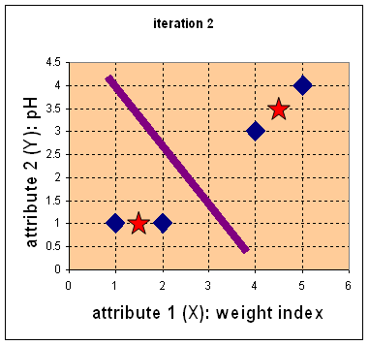


Iteration-1, Objects clustering:Based on the new distance matrix, we move the medicine B to Group 1 while all the other objects remain. The Group matrix is shown below
Iteration 2, determine centroids: Now we repeat step 4 to calculate the new centroids coordinate based on the clustering of previous iteration. Group1 and group 2 both has two members, thus the new centroids are
and

Slide 23
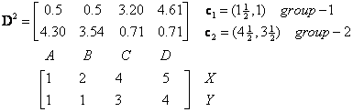
Iteration-2, Objects-Centroids distances : Repeat step 2 again, we have new distance matrix at iteration 2 as

Slide 24

Iteration-2, Objects clustering: Again, we assign each object based on the minimum distance.
We obtain result that comparing the grouping of last iteration and this iteration reveals that the objects does not move group anymore.
Thus, the computation of the k-mean clustering has reached its stability and no more iteration is needed..

Slide 25
We get the final grouping as the results as:
Object | Feature1(X): weight index | Feature2 (Y): pH | Group (result)
Medicine A | 1 | 1 | 1
Medicine B | 2 | 1 | 1
Medicine C | 4 | 3 | 2
Medicine D | 5 | 4 | 2

